Slide 1

PROJECT
Analysis presentation.

Slide 2
CONTENTS
In the slides below I have summarized my project analysis as well as the recommendations to Microsoft company.
Overview
Details
Research
Questions
Recommendations

Slide 3
Project Introduction
1
OVERVIEW

Slide 4

OVERVIEW
With the new wave of excellence that big companies have been having in creating original video content, Microsoft finds the new space interesting.
They have decided to create a new movie studio.
The Problem
The Task
I was tasked to explore the types of films currently doing the best at the box office and translate the findings into actionable insights.

Slide 5
Project Introduction
2
DETAILS

Slide 6
DETAILS
I worked with the following datasets;
imdb.title.basics
imdb.title.ratings
tn.movie_budgets

Slide 7
DATA CLEANING
Missing data.
Structural issues
Merged relevant datasets

Slide 8
DETAILS
I did the analyses guided by the following research questions;
QUESTION 1
What specific genres or storylines that resonate well with audiences and are successful.
QUESTION 3
Which movies have had the highest ROI(Return On Investment) on Production Budgets and box office earnings.
QUESTION 2
Are there specific release windows or seasons that tend to generate higher box office revenues.

Slide 9
3
RESEARCH QUESTIONS

Slide 10
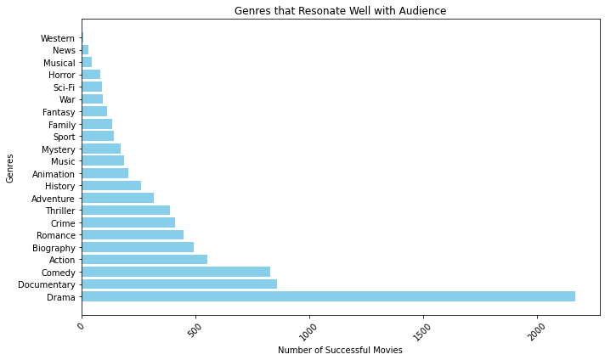
QUESTION 1
Specific genres that resonate well with audiences and are successful.
+
Popular genres
A large population prefers genres with;
Compelling storytelling
Emotional depth
Character driven narratives
As well as;
non-fictional, informative and thought-provoking content.

Slide 11
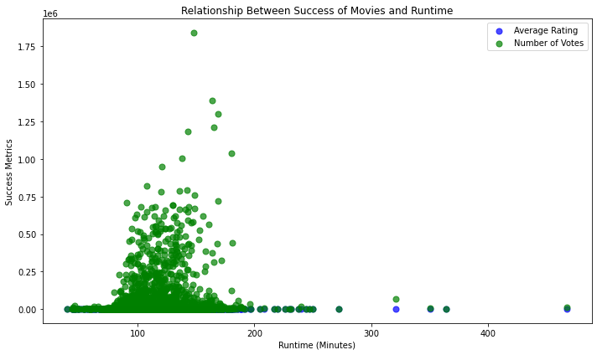
Movie Runtime
Zero influence
The runtime of movies did not affect the popularity or preference of the movies. This meant that the population preference was not fueled by the runtime.

Slide 12
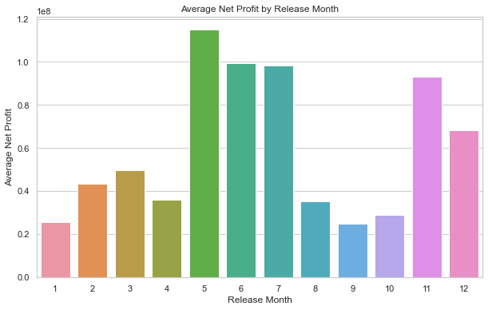


Question 2
Specific release windows or seasons that tend to generate higher box office revenues.
May
June
July
November
August
October
September
January
February
The months with high revenues show that they were months were many were in school vacations, holidays and in their leisure time. The month of May and November showed that they were months of preparation to the vacations and holidays.
Low revenues were recorded in January and September indicating the busiest times for customers.

Slide 13
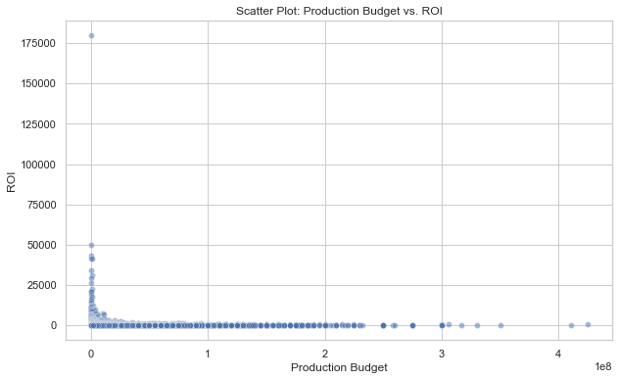

QUESTION 3
Effect of Production Budgets on the Return On Investment(ROI).
The ROI is not interfered whether the budget is increased or not.

Slide 14
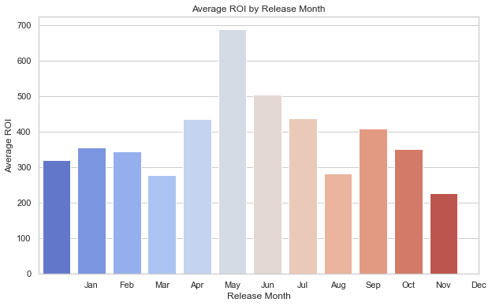
QUESTION 3
Effect of release months on the ROI
MAY
The highest ROI was recorded in the month of May and the least was the month of December. This can be explained due to the high revenues that were experienced in that month.
DECEMBER

Slide 15
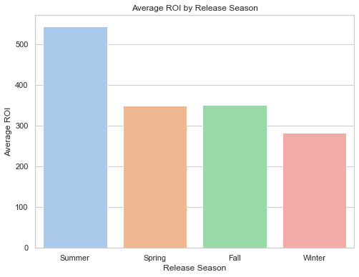
QUESTION 3
Effect of release seasons to the ROI
SUMMER
The highest ROI was recorded in the summer where we know most of the movie consumption was high. This is due to the fact that summer is a time for leisure as well as many vacations happen at this time. In winter most of the customers are recorded to be busy with work and school as well.
WINTER

Slide 16
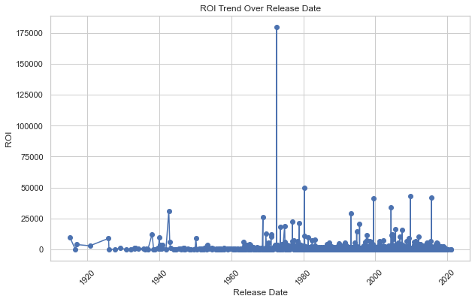
QUESTION 3
Effect of release dates on the ROI over time.
Fluctuated
Over time, the ROI has had fluctuations with no clear trend. This could be due to many external factors with the leading being the economic conditions, changes in audience prefereces or the success of indivindual movie releases.

Slide 17
Business
4
RECOMMENDATIONS

Slide 18
Recommendation 1
Focus on Drama, Documentaries and Comedy genres.
As Drama is the most preferred genre among the audience and Documentaries and Comedy also perform well, consider investing more resources and efforts in producing movies in these genres. They have proven to be popular choices and are likely to attract a larger audience.
1
2
Drama
3
Documentaries
Comedy

Slide 19
Recommendation 2
Flexible Runtimes.
Since the runtime of movies did not significantly affect the popularity or preference, you have the flexibility to explore various runtime options based on the story and creative vision of each film. This allows for more creative freedom without worrying about runtime constraints.

Slide 20
Recommendation 3
Strategic Release Timing
Plan your movie releases strategically to coincide with peak seasons, such as the summer months and November before Christmas. These periods tend to have higher revenues, driven by increased leisure time and holiday festivities. Consider scheduling major releases during these times to maximize box office success.

Slide 21
Recommendation 4
January and September Release Strategy.
Recognize that January and September are busy months for many customers, and the leisure time may be limited due to work and school commitments. Therefore, consider adjusting the release strategy during these months, focusing on genres that appeal to a more niche audience or smaller budget films.

Slide 22
Recommendation 5
Budget and ROI Management.
Since the ROI does not seem to be significantly affected by the budget, be cautious about overspending on production costs. Focus on optimizing budget allocation and ensure prudent financial management without compromising the quality of the films.

Slide 23
Recommendation 6
Adaptation to Market Fluctuations.
Recognize that the ROI has shown fluctuations over time, potentially influenced by various external factors. Stay agile and adaptable to changing market conditions, economic shifts, and audience preferences. Continuously monitor industry trends and adjust your film production and marketing strategies accordingly.

Slide 24

CONCLUSION
I believe that by implementing these recommendations, Microsoft's new movie studio can make informed decisions and position itself for success in the dynamic and competitive movie industry.

Slide 25
THANK YOU !

